Slide 1
CEIS 114 Final Project Deliverables PowerPoint
Name: Tavaughn MAson
Professor: Abdulmagid omar
Session: 60270
Date: Aug 30 2024

Slide 2
Project Plan for IoT Traffic Controller Module 2

Slide 3
ESP32 WiFi Scan
Screenshot of Serial Monitor showing the available networks

Slide 4
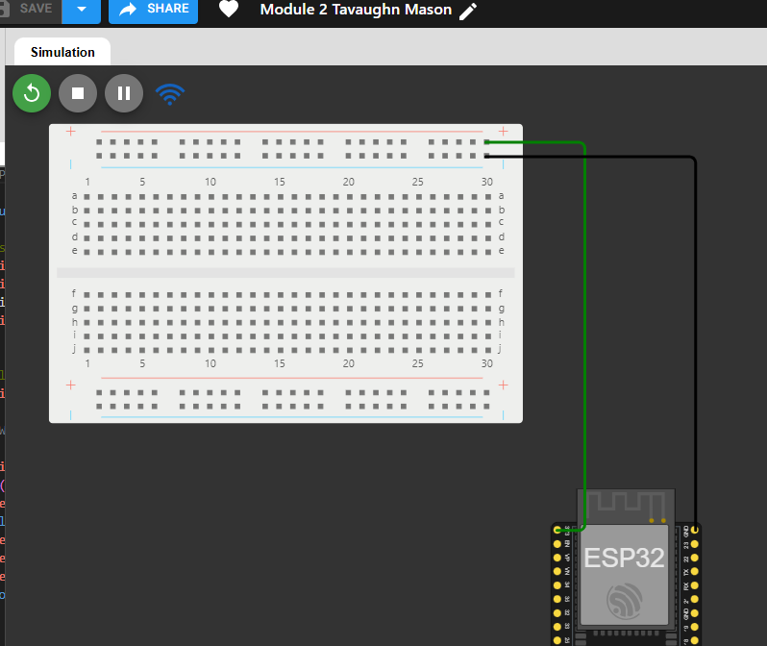
Microcontroller mounted and powered ON
ESP32 (Screenshot)

Slide 5
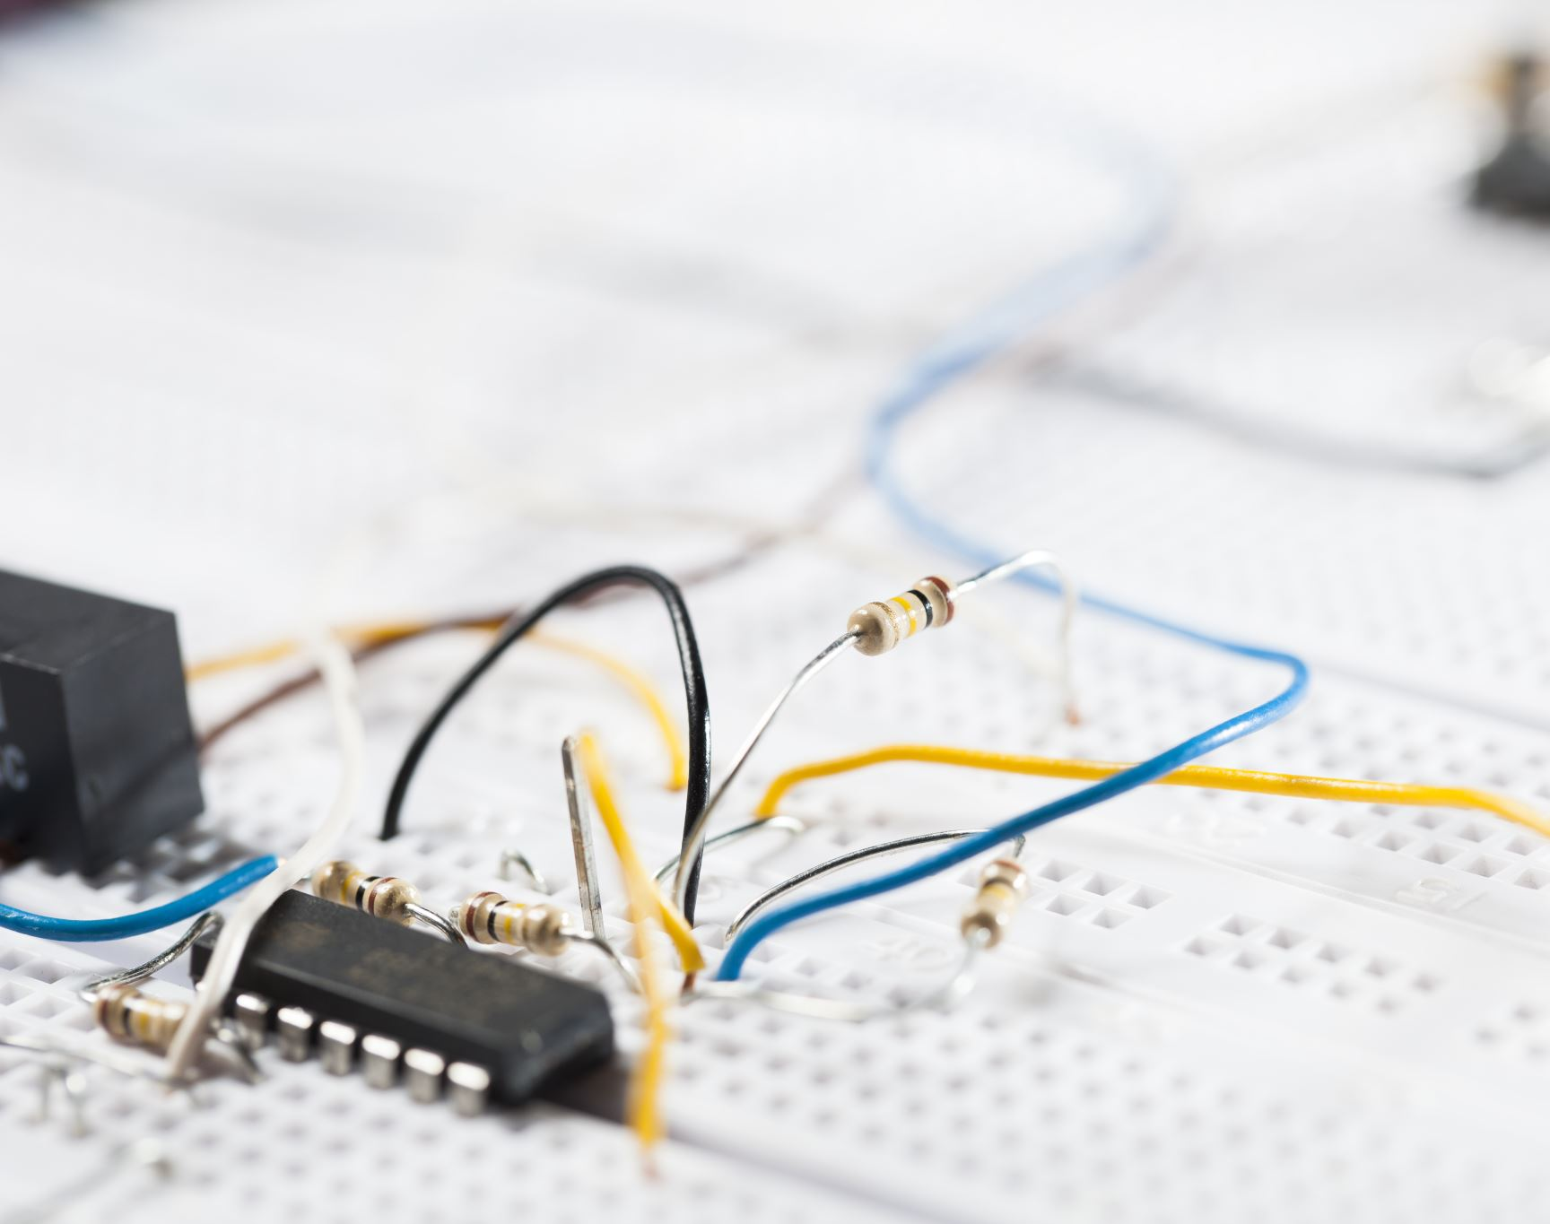
Module 3 Creating the Traffic controller

Slide 6
Picture of circuit with working LEDS

Slide 7
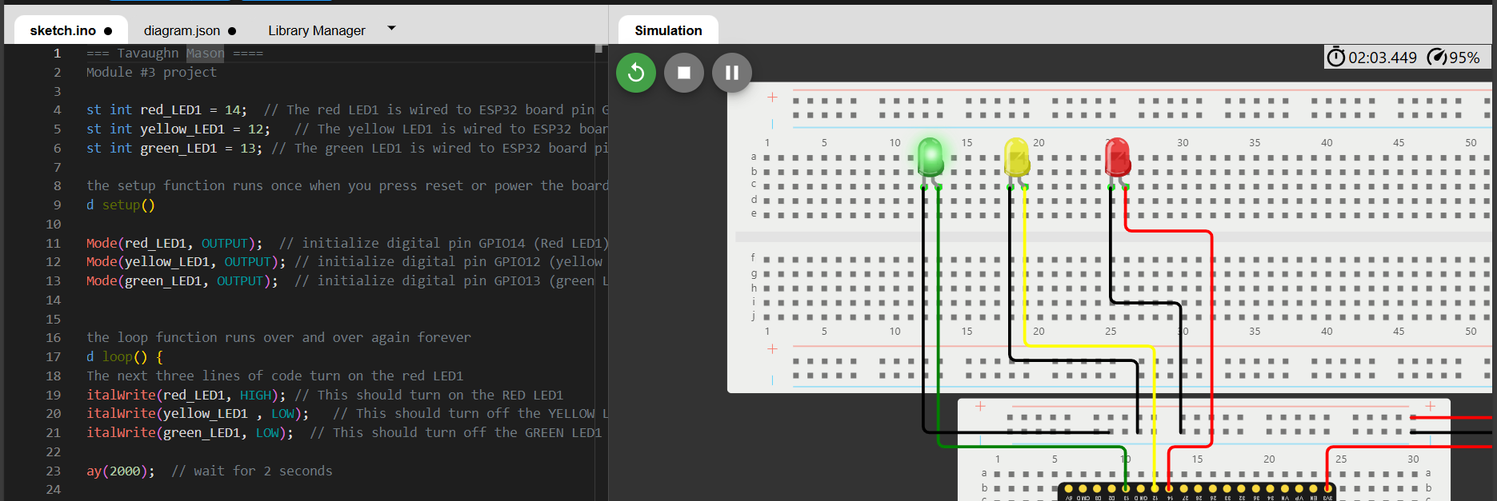
Picture of circuit of with working LEDS cont.

Slide 8
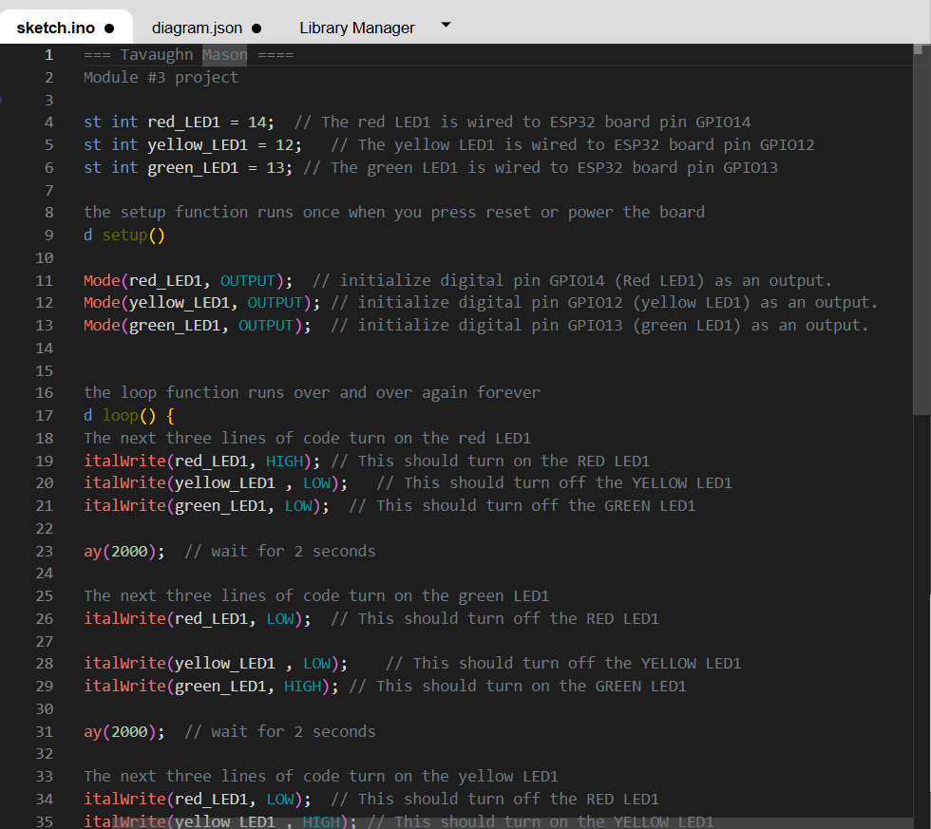
Screenshot of Code in Editor

Slide 9
Creating a multiple traffic light controller

Slide 10
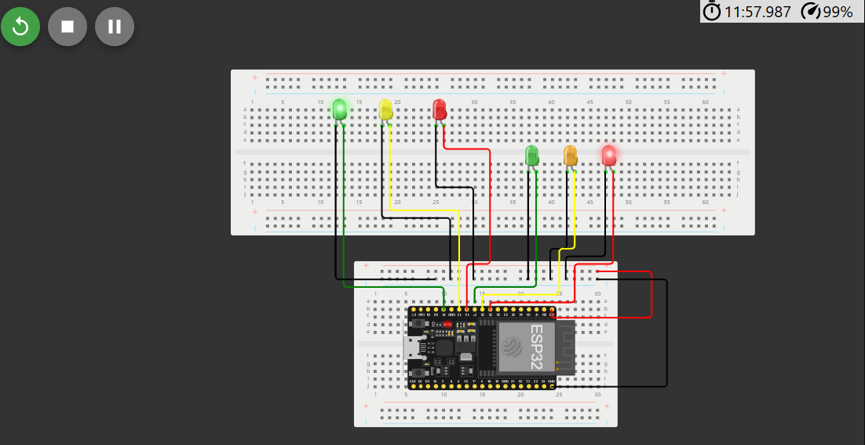
Picture of Circuit with Multiple LEDS working

Slide 11
Screenshot of working code from Wokwi

Slide 12
Module 5 Creating Multiple traffic controller with crosswalk

Slide 13
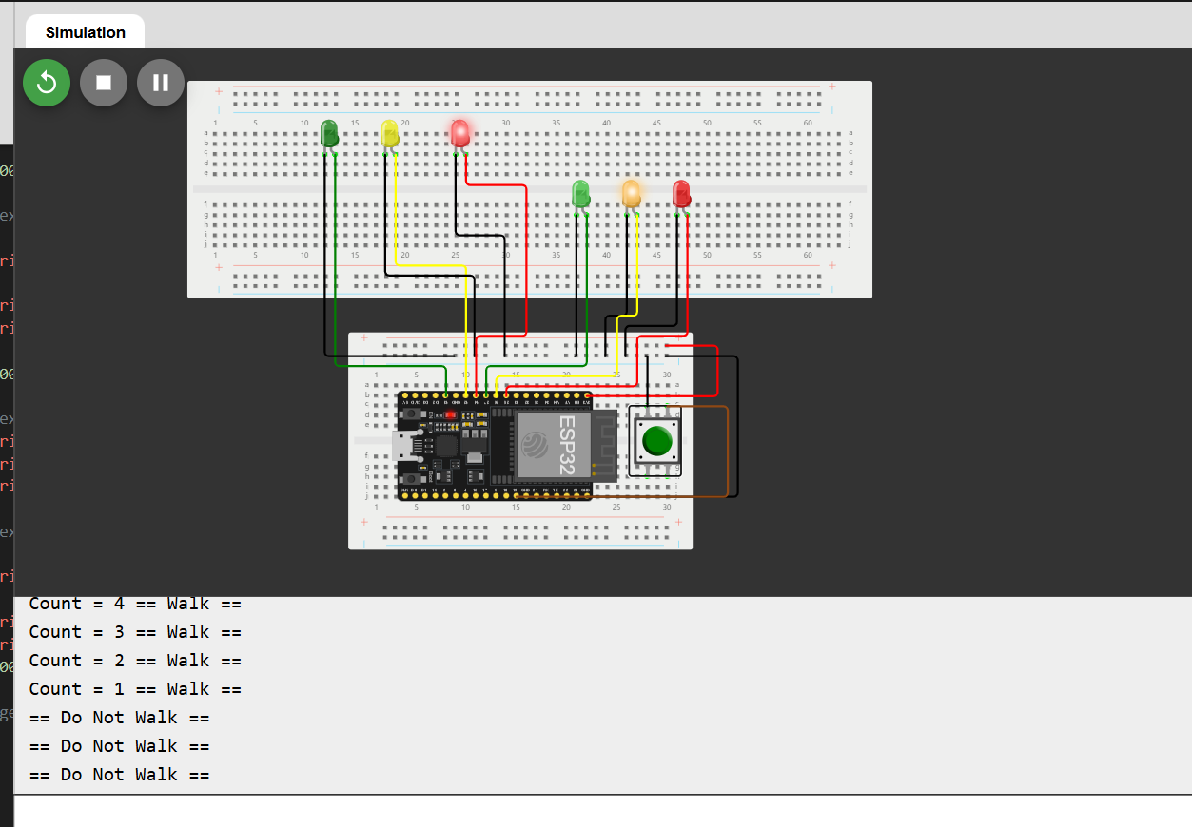
Picture OF circuit with Leds and Crosswalk pushbutton

Slide 14
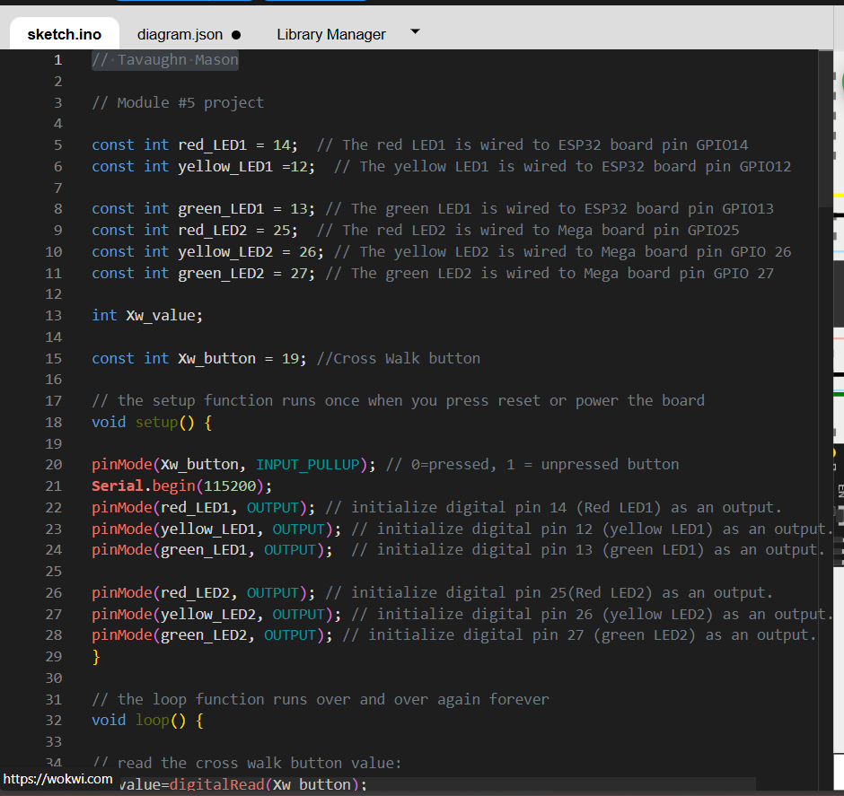
Screenshot of of Working code from Wokwi

Slide 15
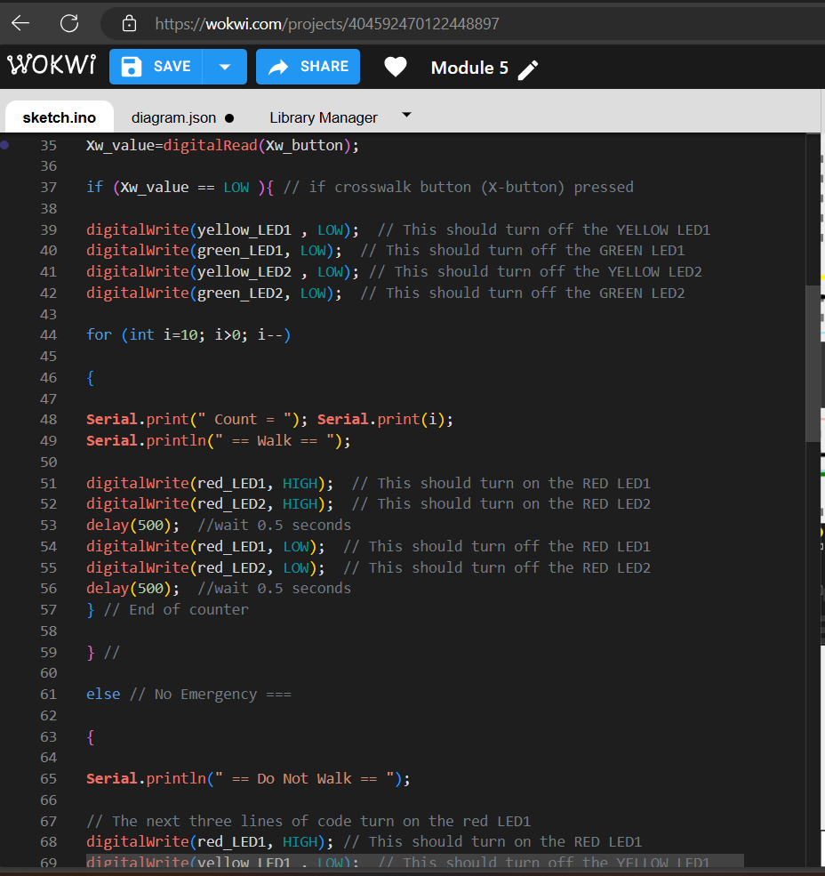
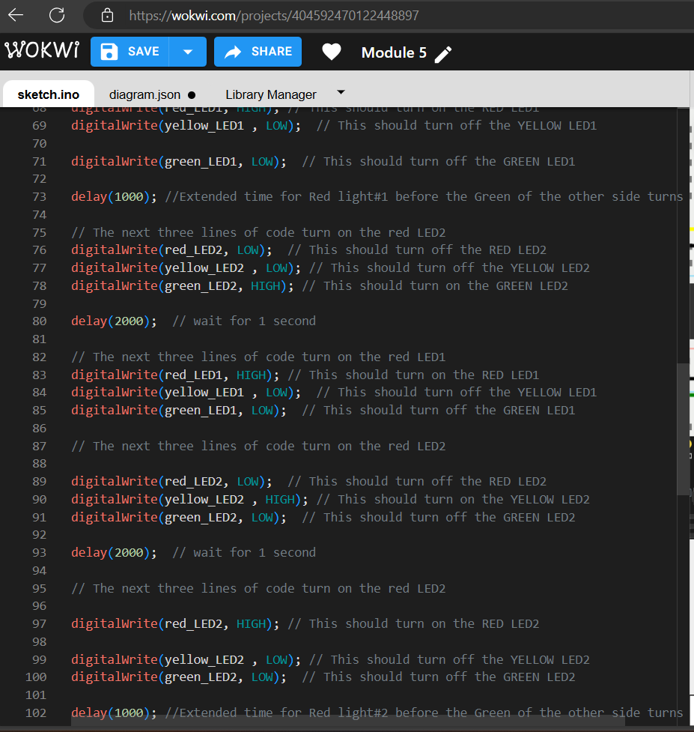

Slide 16
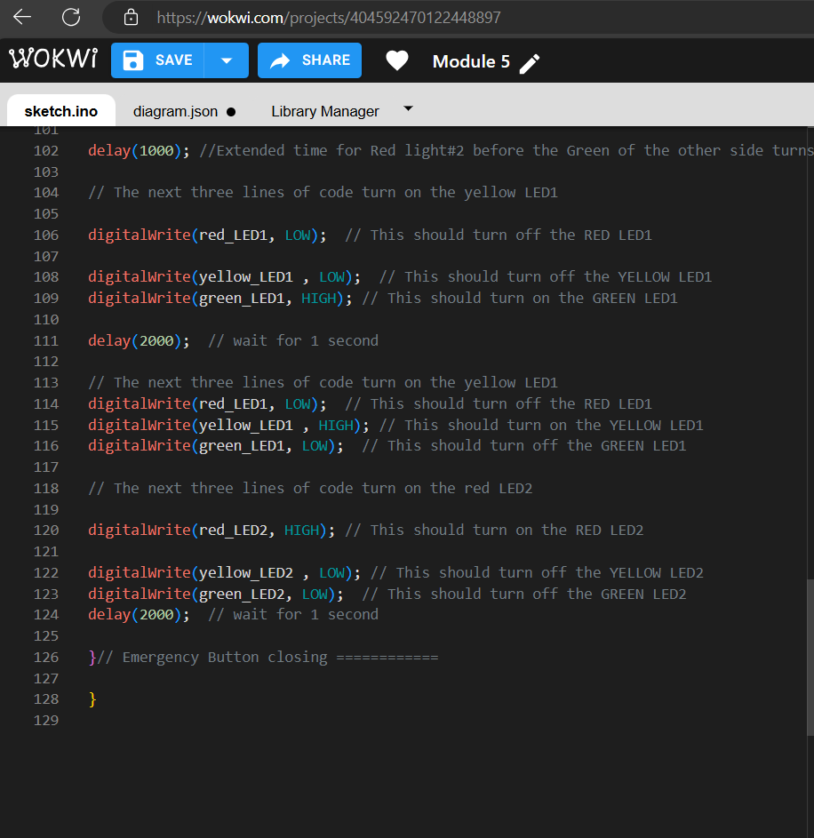
Screenshot of code from Wokwi cont.

Slide 17
Creating a multiple traffic light controller with a crosswalk and emergency button

Slide 18
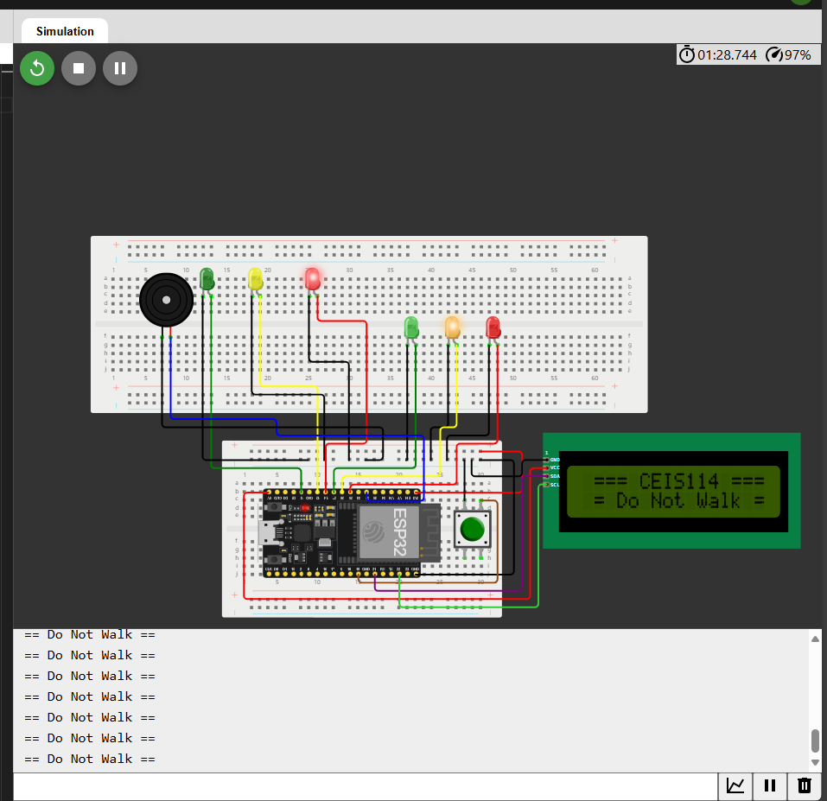
Picture of circuit with crosswalk emergency button and lcd

Slide 19
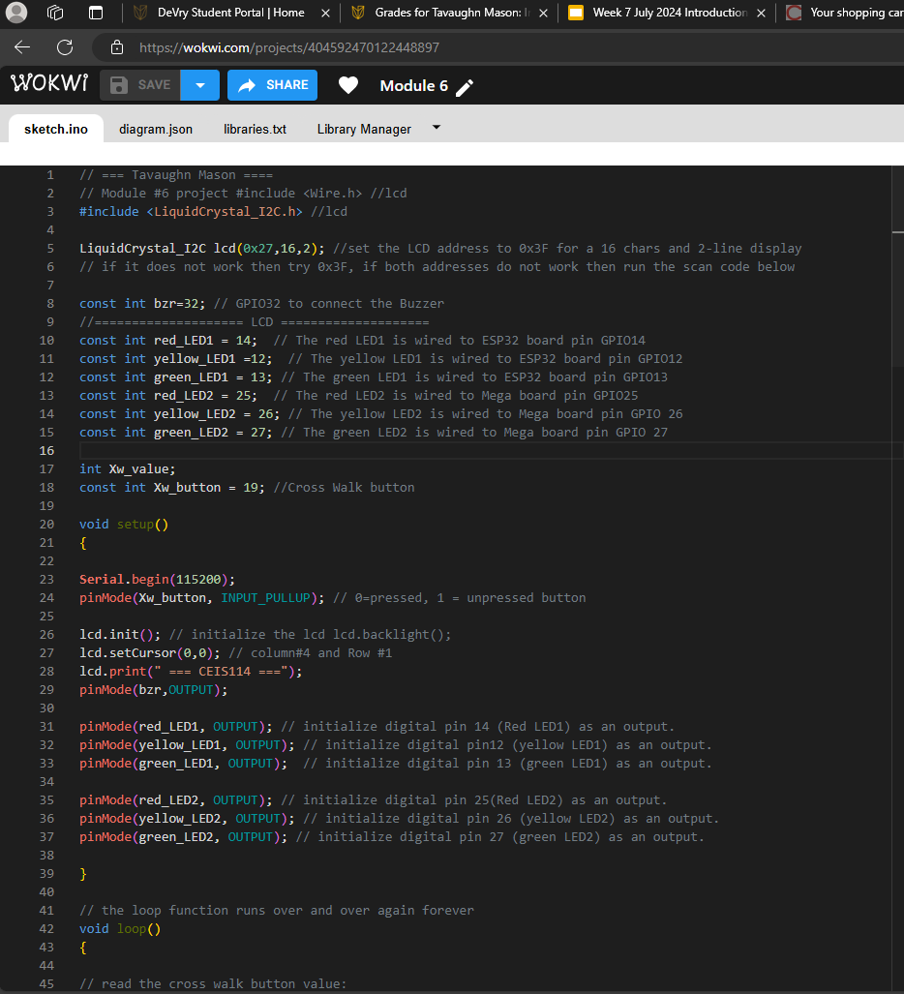
Picture of working code from wokwi

Slide 20
Module 7 Creating a multiple traffic light controller with a crosswalk and emergency buzzer secured with Iot control via web

Slide 21
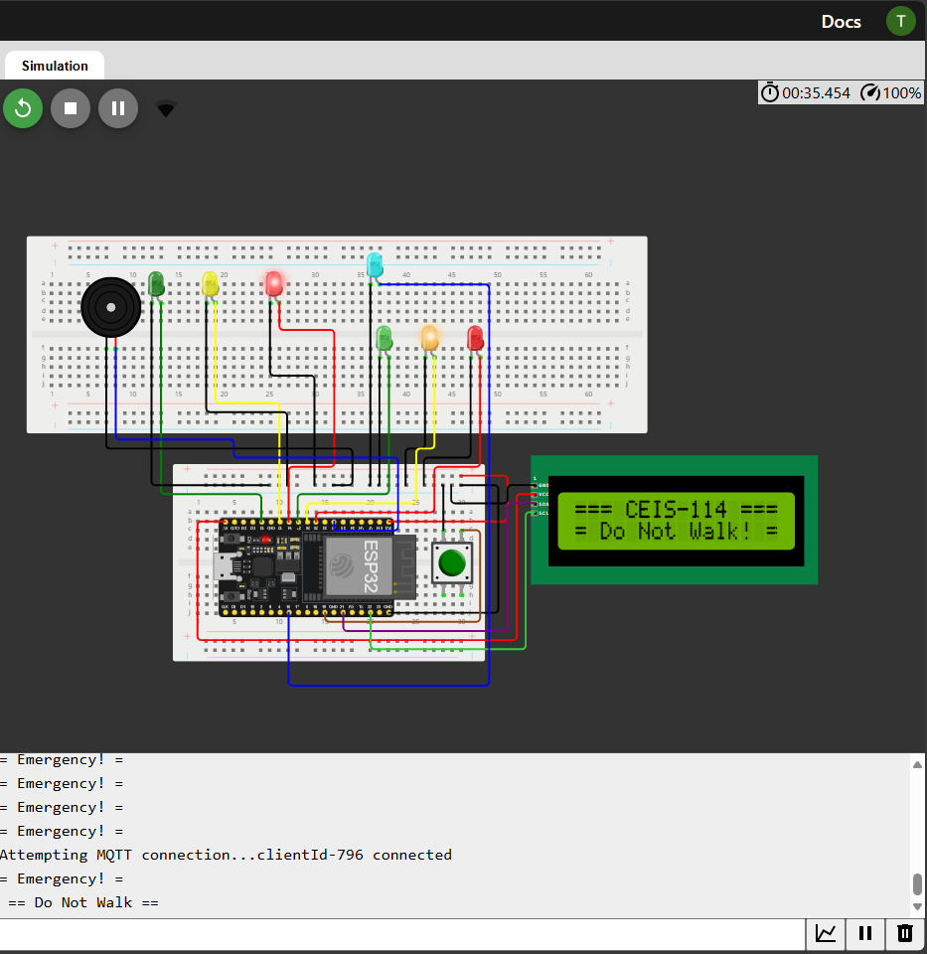
Screenshot of working leds with lcd display (building operation)

Slide 22
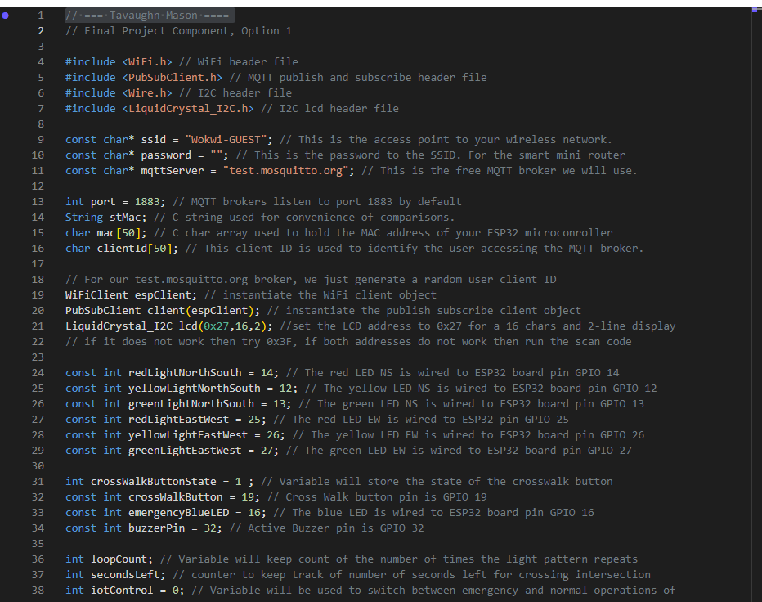
Screenshot of code editor

Slide 23
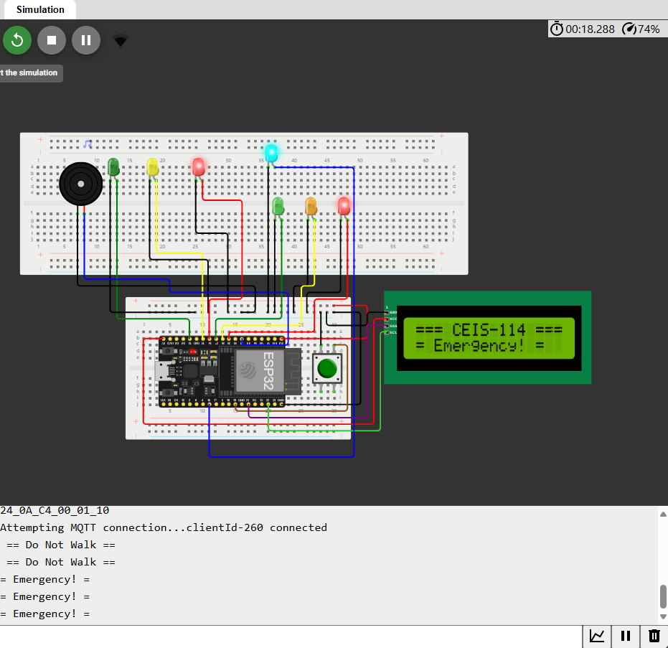
Screenshot of serial monitor testing

Slide 24
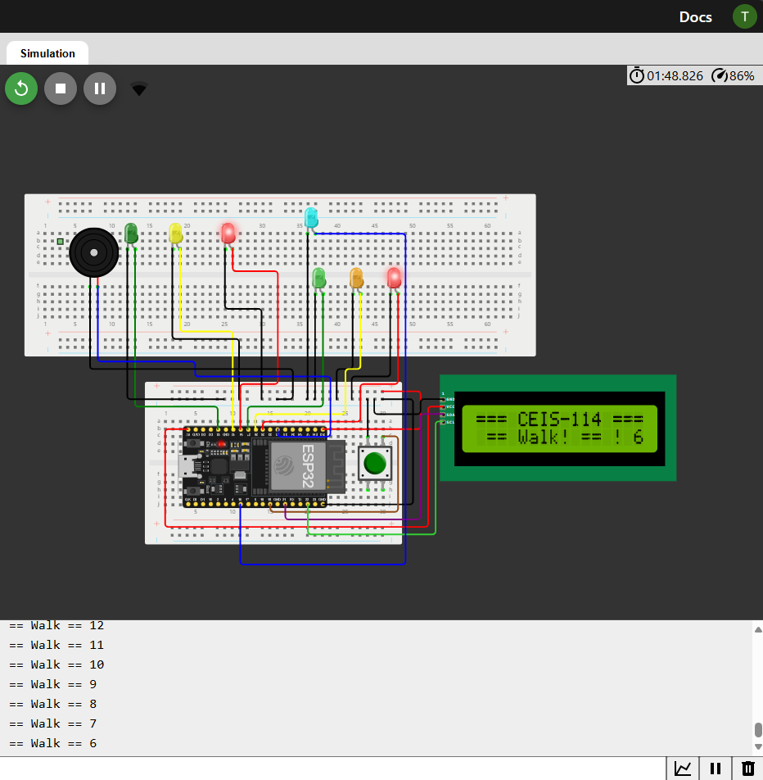
Screenshot of serial monitor cont.

Slide 25
Challenges-
A common challenge I noticed is the ability to incorrectly set the correct timings for each switch for the transitioning lights on the circuit. The incorrect timings could have made the series of light transitions out of sequence, which would have unintended results for the projected outcome. So careful priority into placing and correctly assigning the pin address was crucial. There was also setting up the IoT server connection, which required the use of an external device for activation with the use of the internet. This was my first attempt at using an outside source to navigate the device through an MQTT server, so the idea of being able to control something from the network was new and exciting. Although I had no issues setting it up due to my prior experience setting up networks, I can still see how someone new to the process could easily mistype or assign the wrong port ID.
Career skills-
The career skills I gained from this course explore the fundamental foundation of electronic, digital, and system integration concepts common in modern computing devices.
Conclusion-
As a student, I want to thank my instructors for allowing me to explore the ever-evolving field and market of digital devices. This knowledge has helped me expand my practical application to develop and prototype real-world device solutions in the Internet of Things.
References
Internet of things | IOT solutions | software AG. (n.d.). https://www.softwareag.com/en_corporate/platform/iot.html

